Slide 1
EFG HOLDING · DATA SCIENCE
Welcome
Algorithmic Trading Internship — 2026 Cohort

Slide 2




WHO WE ARE
AI Enablement
The Data Science Team
at EFG Holding
Building the organization's capacity to use AI. Hands-on Copilot workshops, department by department — people leave the session using AI, and we track whether that sticks.
AI-Powered Operations
The Agent Shift
Embedding AI across every major business function — from document processing to customer analytics to operational workflows.
Replacing the mechanical execution layer of operational roles with intelligent agents. EFG-owned, enterprise-grade.

Slide 3

THE OBJECTIVE
Something new, this time.
We've decided to try something different with this program: merge the core of what we do — data science — with what EFG Hermes is most famous for: the stock market.
With a flavor you'll actually relate to.

Slide 4
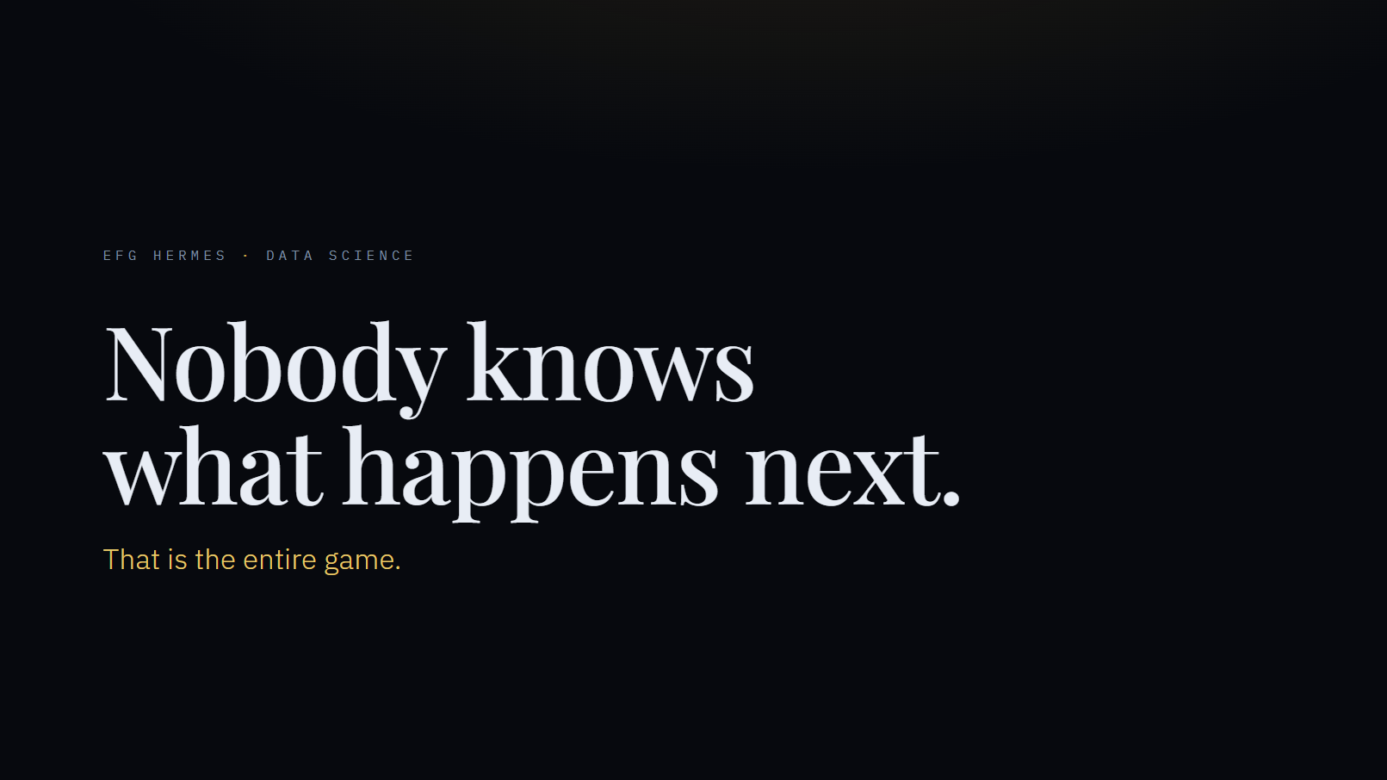

Slide 5
IN THIS INTERNSHIP
Skills for right now. And skills for life.
01
You'll learn new skills
As a programmer, and as a data scientist — real tools, used the way professionals use them.
Python, version control, full-stack development, vibe coding, deep learning
02
We're giving you a real problem
Not a toy exercise. Something genuinely difficult to think about and try to solve.
03
You'll learn to diagnose a strategy
Not just whether it works — but why it doesn't. That's the difference between a real edge and a lucky run.
04
The skill outlives the internship
Reading and understanding markets is something you'll keep using for the rest of your career.

Slide 6
We see you as seeds.
The ones who will reshape Egypt's stock market.
A totally new segment of participants — with the power to actually change it.

Slide 7

THE STRUCTURE
Three weeks.
WEEK 1
WEEK 2
WEEK 3
Learn the market. Build the engine.
Prediction, and why it's harder than it looks.
An agent that learns.
Indicators, a real strategy, honest backtesting — and your own dashboard.
Models, the pivot, and Modern Portfolio Theory.
Reinforcement learning — build something that adapts on its own.

Slide 8

Let's see it in action.
LIVE DEMO — THE DASHBOARD

Slide 9

BEFORE WE START
Let's get set up.
VS Code is installed and open
Reading material:
learn\01-stock-market
learn\02-algo-trading
Git is installed
The repository is cloned to your machine
You've been added as a GitHub contributor
Access to any AI

Slide 10

Let's begin.
EFG HOLDING · DATA SCIENCE

